Slide 1
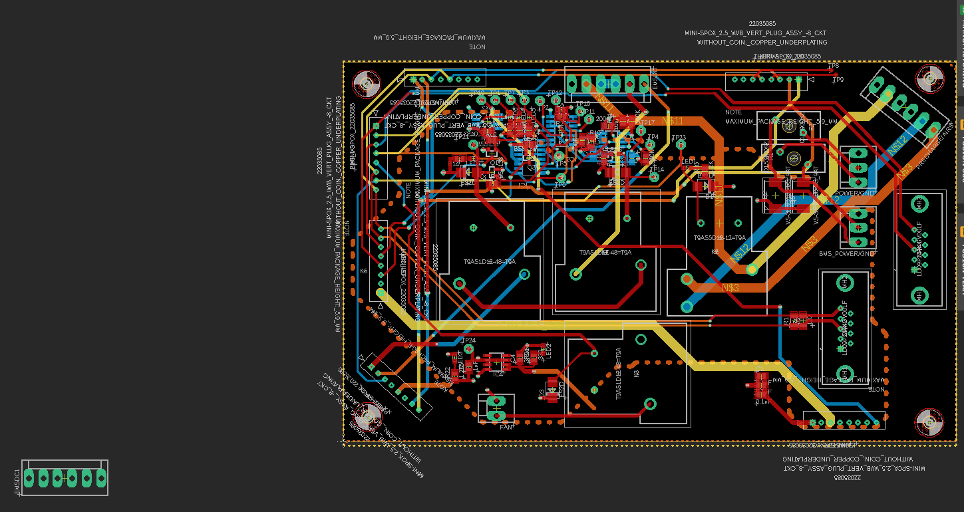
Create a bill of material, this can be done in schematic view. (https://www.lioncircuits.com/faq/pcb-assembly/how-to-generate-BOM%28Bill%20of%20Materials%29-from-EagleCAD) Links to components should go in that not on the board design
The dsub connectors could be horizontally aligned
Why have you kept the crappy connectors for the EMSDC, PRE_CHAERGE/AIRS etc.?
Logo
Designer info
Names of connectors on silkscreen
Pinout written on silkscreen for connectors where space
Silk screen is unreadable around logic components
`
Whats this doing here?

Slide 2
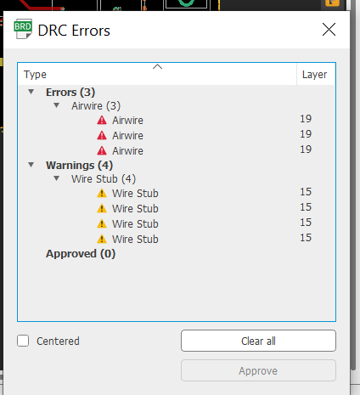
Do a design rules check

Slide 3
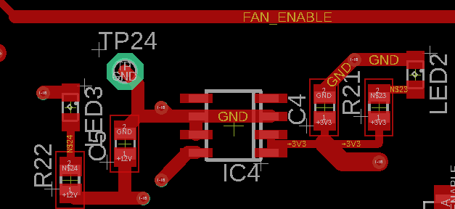
Decoupling caps closer to chip (all logic chips not just the one below), suggested position is orange rectangle Label what the LEDs are on the silkscreen, what purpose to they serve, need more info on the silkscreen general

Slide 4
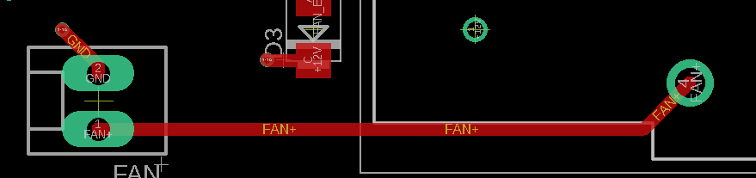
Fatter traces for fans, they might actually draw a fair bit of current

Slide 5
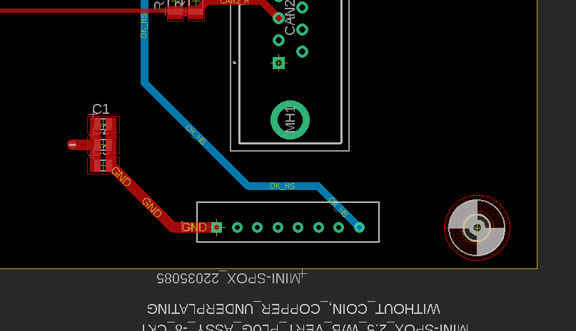
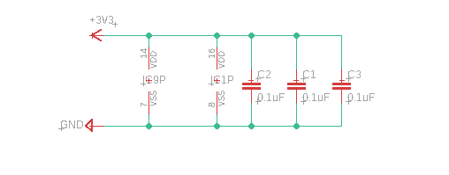
THESE ARE DECOUPLING CAPACITORS FOR IC9 AND IC1 (THINK C3 IS NO LONGER REQUIRED AS THIRD IC DELETED). THEY SHOULD BE AS CLOSE TO THE CHIPS AS POSSIBLE. CURRENTLY THEY ARE THE OPPOSITE END OF THE BOARD

Slide 6
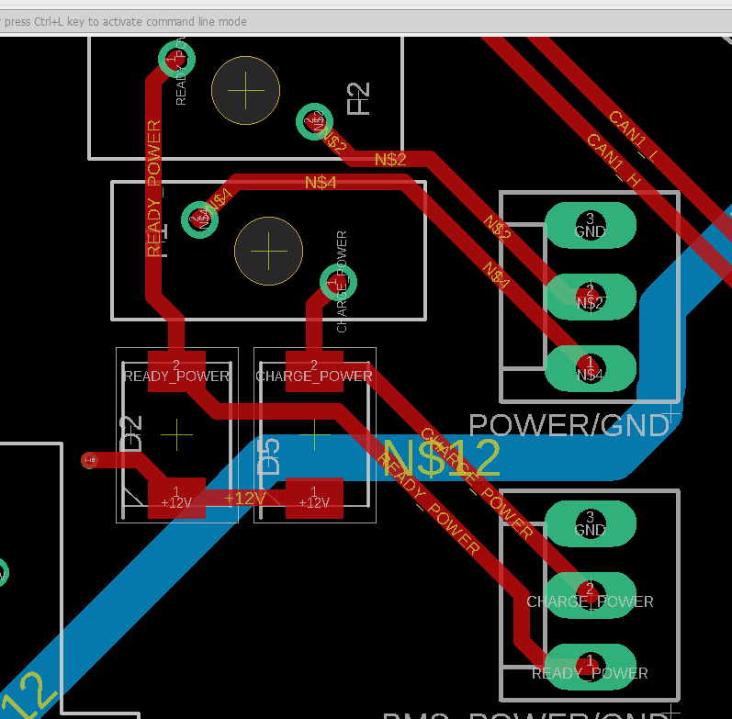
THIS IS THE MAIN LV POWER INPUT TO THE WHOLE BATTERY, THESE TRACES NEED TO BE MUCH THICKER. THEY CARRY A FEW AMPS. ALSO DON’T ROUTE TRACES UNDER COMPONENTS IF YOU CAN HELP IT. THE SIZE OF A COMPONENTS PADS INDICATE HOW MUCH CURRENT IT CARRYS AND HOW THICK THE TRACES SHOULD BE
If you can use thicker traces, use thicker traces.

Slide 7
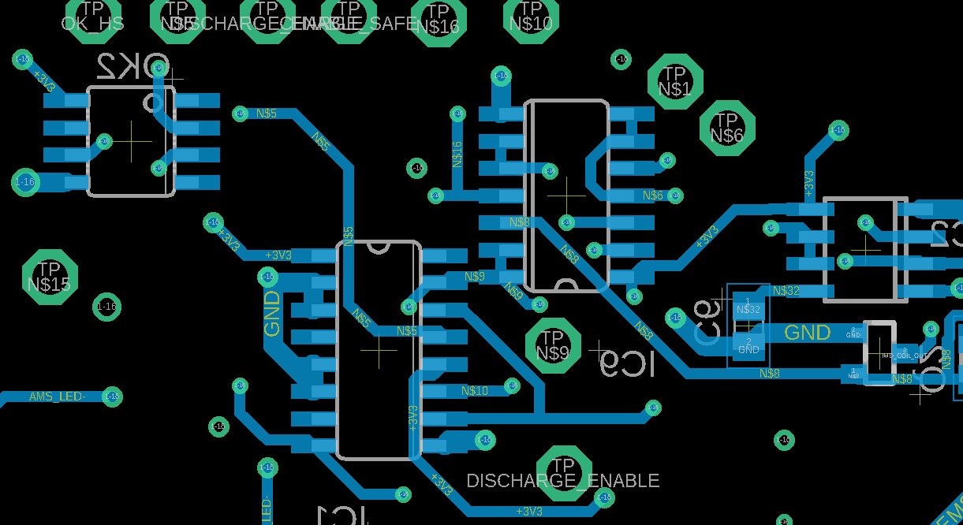
Clearances here are not large enough, if you do a DRC check with manafactuers clearances it probably wont pass. Even if it does it is still not good practice, bring the trace straight out away from the pin before using angles
Chips are way too close, this will be a pain to solder

